Slide 1
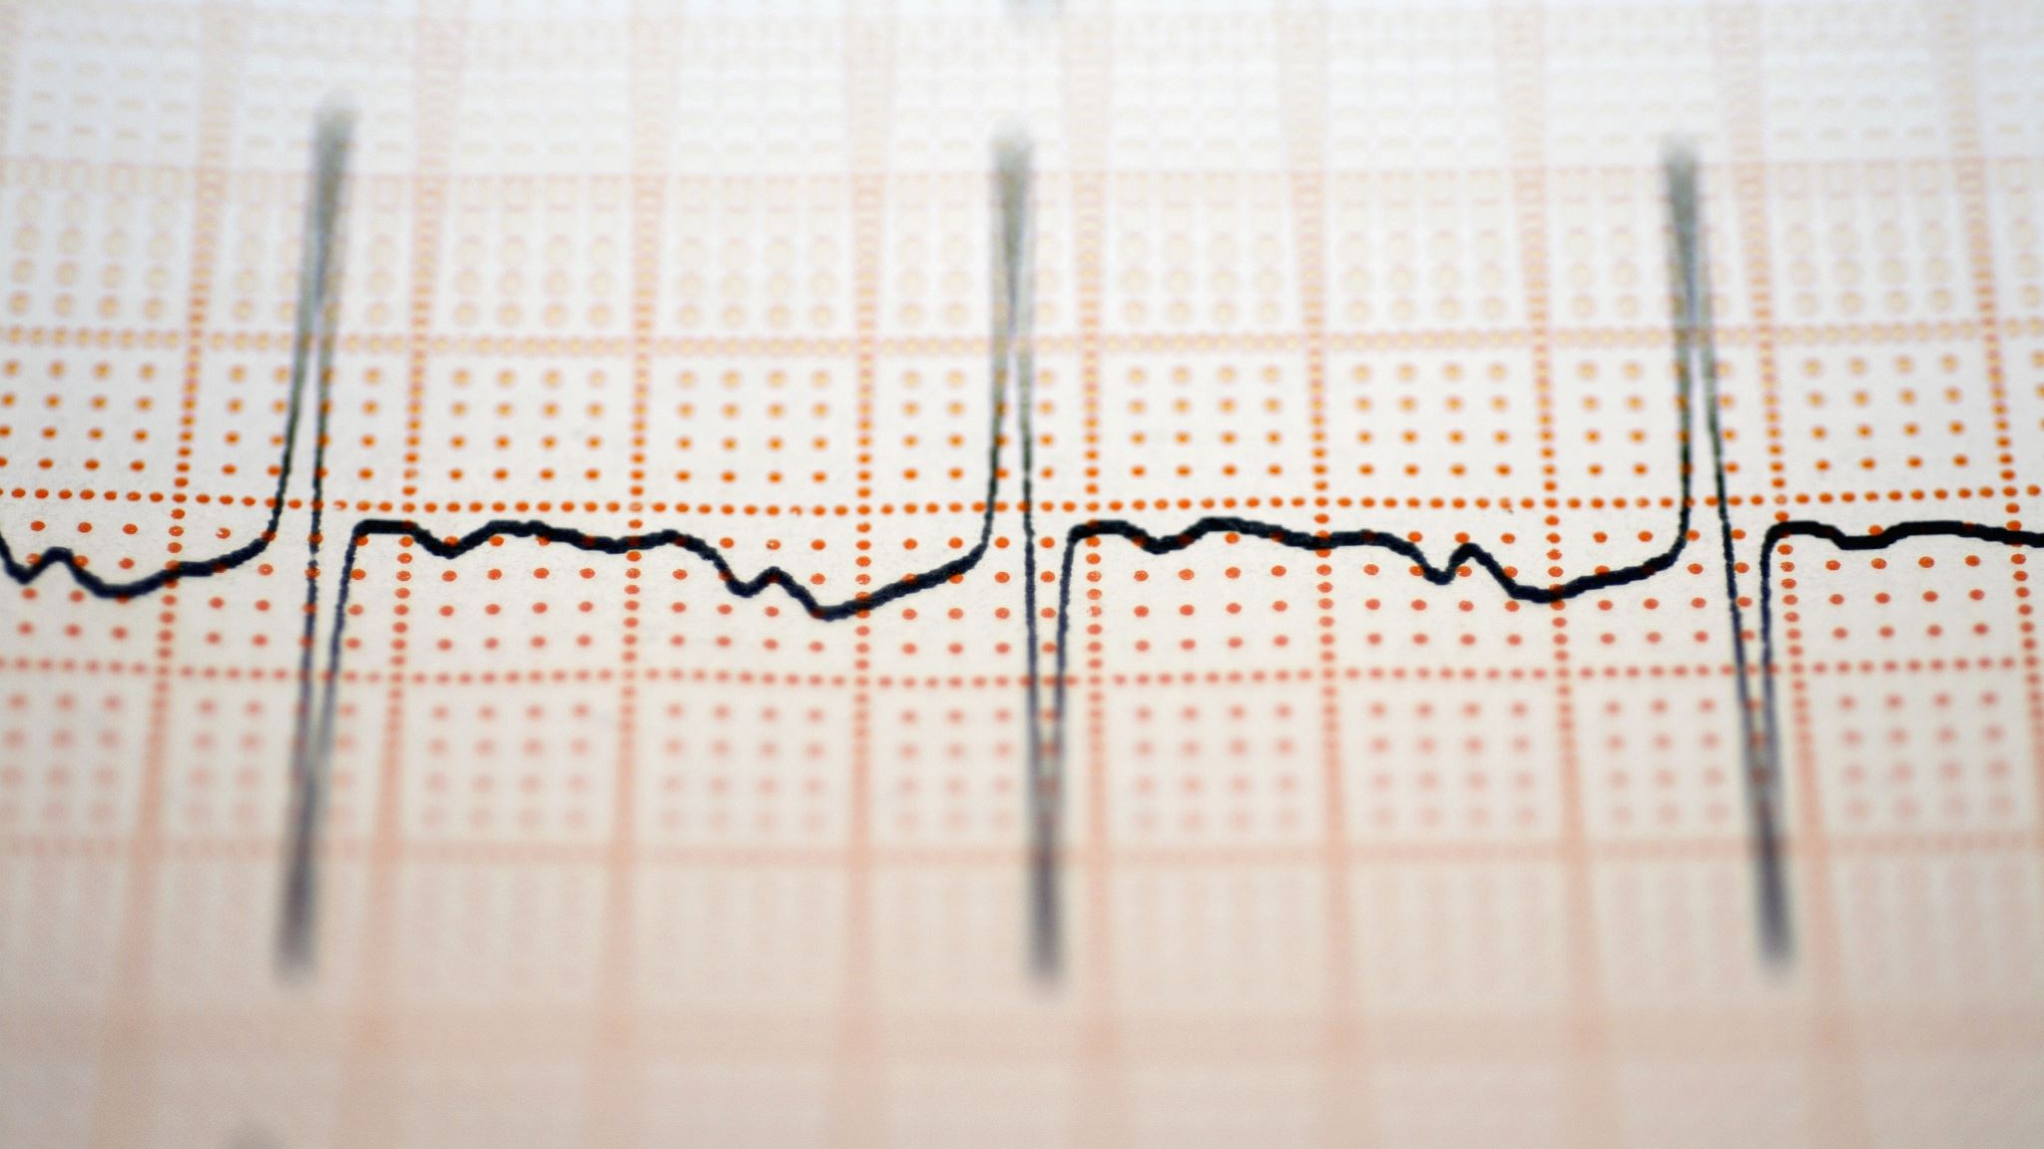
Cancer dataset UAE
Hamdah Alkindi H00492795
Mariam Jasim H00492025
Afra Almansoori H00496444
Shaimaa Abdulrahman H00532150

Slide 2
https://github.com/h7amdahh/cancer_dataset_uae https://www.kaggle.com/datasets

Slide 3
We are going to introduce our project, which is based on working with a real dataset, machine learning model application, and utilizing Git and GitHub for teamwork today. The entire group collaborated in getting familiar with the data, writing the code, and producing each deliverable little by little. In this presentation, our aim is to display our learning outcomes, the application of techniques, and the results we got during the project.

Slide 4
Derivable 1

Slide 5
Hamdah
As a group, we collaborated to create and execute the Python code for this aspect of the project. The functions descriptive_stats() and sampling were among those that we implemented. Our collaboration boosted our comprehension of the results as each member unpacked a portion they grasped. Code execution was a demonstration of how the statistics get calculated and how the dataset is altered post-sampling. In short, this part has been a great source of both our teamwork and Python skill confidence.

Slide 6
Mariam
Our group helped each other with the code in this section. We used Python to read the data, take samples, and calculate basic statistics. Sometimes the code gave errors, but we fixed them together. This made the work easier and clearer for everyone. By doing the coding as a team, we learned more about data analysis and how to understand the output.

Slide 7
Afra
In this task, our group used simple Python code to explore the dataset. We worked on sampling, descriptive statistics, and printing results using pandas. Each member tried running the code and shared their understanding with the group. This teamwork helped us learn faster and understand why each step in the code is important. The experience also improved our communication and problem-solving skills.

Slide 8
Shaimaa
As a group, we used Python code to analyze the data in this part. We supported each other with the coding steps and explained the output together. Using the code helped us understand the dataset better and working as a team made the task much easier. This section helped us build both technical skills and teamwork skills.

Slide 9
Derivable 2

Slide 10
Hamdah
In Deliverable 2, the collaboration among our group members made it possible to execute the Python code for descriptive analysis. We utilized some methods to calculate the mean, IQR, skewness, and frequency tables. Cooperation among us enabled us to get a grasp of the value's meaning and the code's operation in a stepwise manner. The code execution allowed us to visualize the dataset's patterns more clearly. Overall, this section was beneficial in upgrading our capabilities in output reading and comprehension of fundamental data statistics.

Slide 11
Maraim
For Deliverable 2, Python was employed to generate random samples and derive descriptive statistics. Initially, a few lines of code produced errors, yet the group collectively resolved these bugs. The utilization of sampling code facilitated our grasp of data alteration when only a portion of the dataset is chosen. The collaboration made the task effortless and allowed everyone to realize the bond between sampling and statistics.

Slide 12
Afra
In Deliverable 2, the distribution of coding tasks was conducted by our team. The coder wrote the code; the checker reviewed the results and the rest assisted in interpreting the statistics. Our totaling and the use of Python libraries like pandas and matplotlib made data visible. Understanding how descriptive analysis worked with large datasets was a team effort. The whole process was made easier with teamwork.

Slide 13
Shaimaa
In Deliverable 2, the distribution of coding tasks was conducted by our team. The coder wrote the code; the checker reviewed the results and the rest assisted in interpreting the statistics. Our totaling and the use of Python libraries like pandas and matplotlib made data visible. Understanding how descriptive analysis worked with large datasets was a team effort. The whole process was made easier with teamwork.

Slide 14
Derivable 3

Slide 15
Hamdah
Our group delivered clustering models based on K-Means and Hierarchical Clustering in this deliverable. We utilized parameters such as Age and Weight and executed the code to observe the creation of clusters. All the members of the team expressed their interpretation of the cluster diagram. The collaboration among us enabled us to discover the hidden patterns in the dataset and to see how the unsupervised learning method can group patients with similar characteristics.

Slide 16
Maraim
In Deliverable 3, the Python code for the regression models was executed by our group together. The impact of Age and Height on Weight was analyzed using simple linear regression and multiple linear regression. Teamwork made it easier for us to grasp the concept of the slope, intercept, and R² score. The code running provided us with a better understanding of the way regression operates in actual data. This section developed our competencies in model building and output interpretation.

Slide 17
Afra
Deliverable 3 involved the development of a classifier model using Python for the purpose of predicting the Outcome. The model was trained by applying label encoding and variable with Logistic Regression through Age, Gender, Cancer Stage, and Weight. The entire team supported each other in debugging the code and interpreting the predictions. Collaboration made it more convenient to grasp the working of machine-learning models in terms of their learning from data and making predictions.

Slide 18
Shaimaa
During the third deliverable, the group wrote Python code for developing regression, classification, and clustering models. We were coding together, and each clarified the results of the others as a team. This enabled us to grasp the functioning of machine-learning models and the interpretation of their outputs. Collaborative effort not only made the tasks simpler but also enhanced our technical skills.

Slide 19
Derivable 4

Slide 20
Haamdah
Our team collaborated each one by creating a GitHub repository and uploading all project files in Deliverable 4. We swept through these learning sessions as a group, assisting each other in understanding how to install Git, link it to GitHub, and structure the directories neatly. The implementation of commands of Git was a hands-on training of how version controlling operates in real scenarios. The teamwork made it all less cumbersome and at the same time we got to know how online code management is done by teams.

Slide 21
Maraim
In this deliverable, we managed to master the techniques of cloning the GitHub repository to our machines and using the commands pull and push. We collectively practiced the commands interchangeably, as a result, everybody was familiar with them. Occasionally, there were minor mistakes, but we rectified them as a group. Such collaboration was fruitful in that it enabled us to learn the accurate procedure and comprehend the transfer of files between Git and GitHub.

Slide 22
Afra
In the fourth deliverable, the entire team made use of GitHub to deliver and modify the files related to the project. We were in touch with one another and assigned the different tasks in a way that every participant uploaded their respective contributions. Mastering the use of Git commands, we also got to know how the people in the field work together on one and the same project without the worry of files getting mixed up or lost. The whole process was a great help in enhancing our cooperation, planning, and tech skills.

Slide 23
Shaimaa
For this deliverable, our team employed Git and GitHub to perform file uploads, pulls, and pushes. We assisted one another with the procedures involved and, in the process, learnt how version control operates. Collaboration facilitated the comprehension of commands and the execution of tasks. This segment enhanced our proficiency in using Git for collaborative projects.

Slide 24
To sum up, our undertaking demonstrated the potential of merging data analysis, machine learning, and GitHub collaboration to produce a neat, well-structured system. As a team, we acquired new techniques, helped one another, and got the gist of how the actual data could be transformed, evaluated, and disseminated. This venture not only increased our technical ability but also enhanced our cooperation. We appreciate your attention.

